Slide 1
Our epic Cowboy shooter game
It realLy is!!

Slide 2
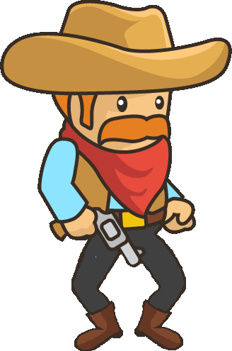
Our first initial plans
Pvp
Person versus person
Campaign
Healthpotions
Cactus to take damage
Horses as speedboosters

Slide 3
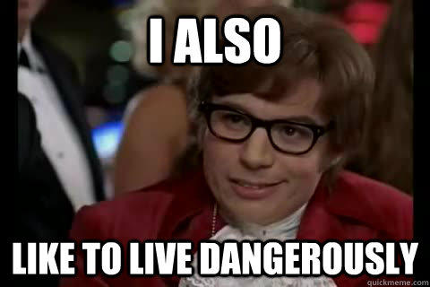
Final Result
PvP
Shooting
Healthbars
Cowboys and indians
Live Demo because we like to live dangerously

Slide 4
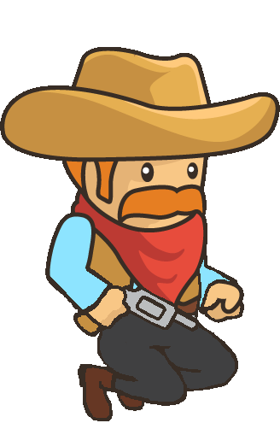
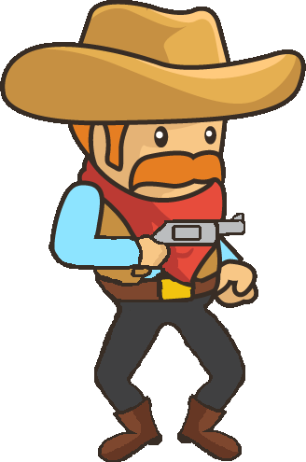
Working in group & what we learned
2 developers
2 designers
A good balance
We learned a lot

Slide 5
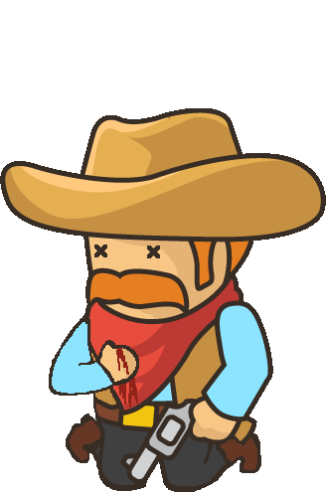
Our slogan
Deliver a lot in a short time. You can sleep later ☺
Someone actually worked all night

